Slide 1
數位數學教材設計
阿力 G11016025

Slide 2
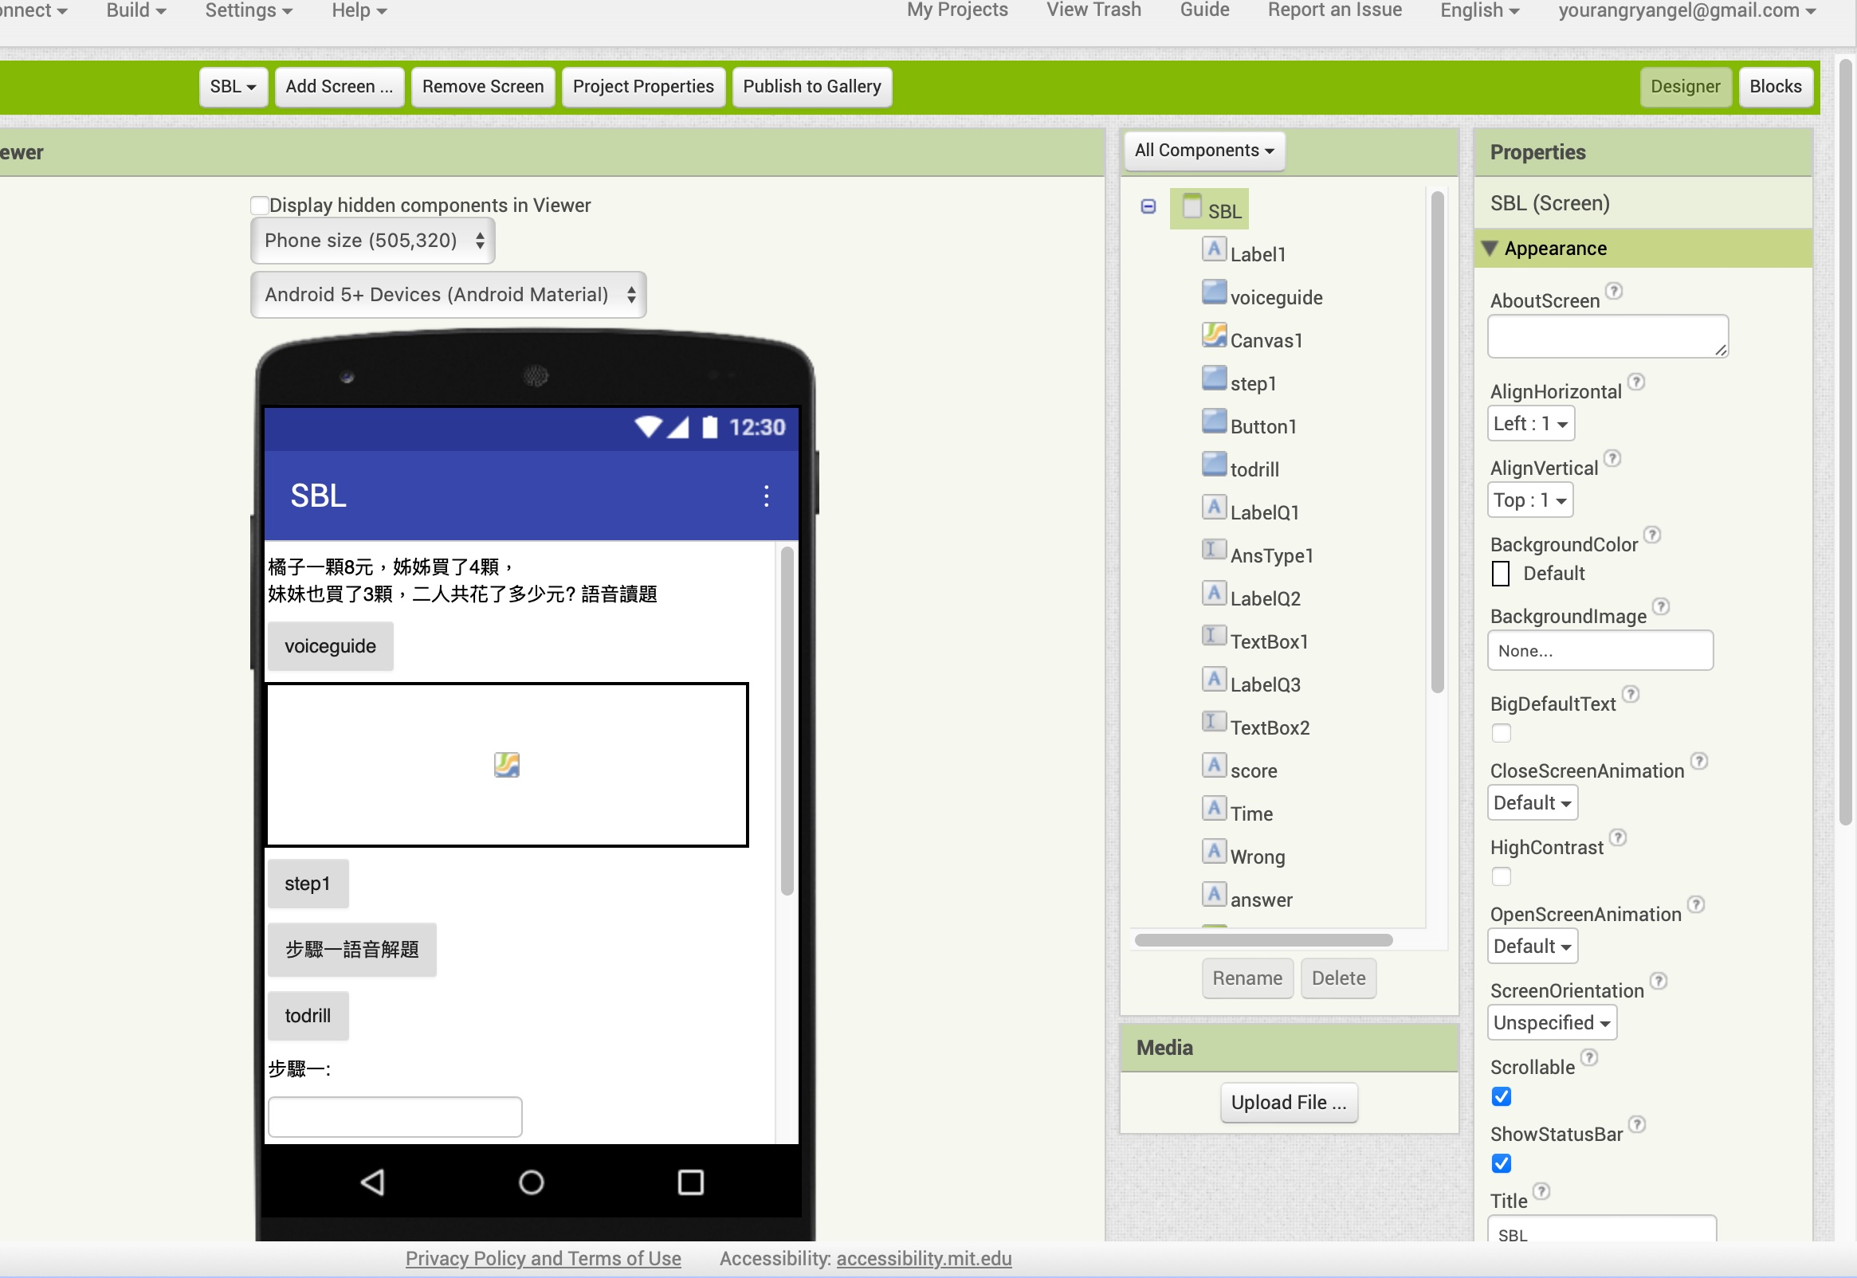

UI

Slide 3
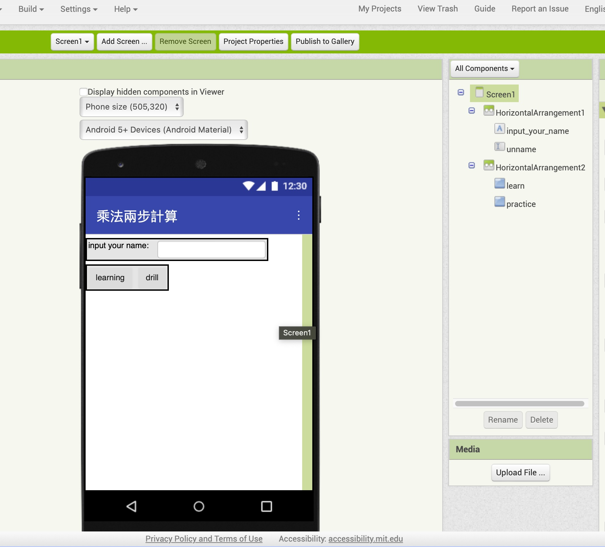

UI

Slide 4
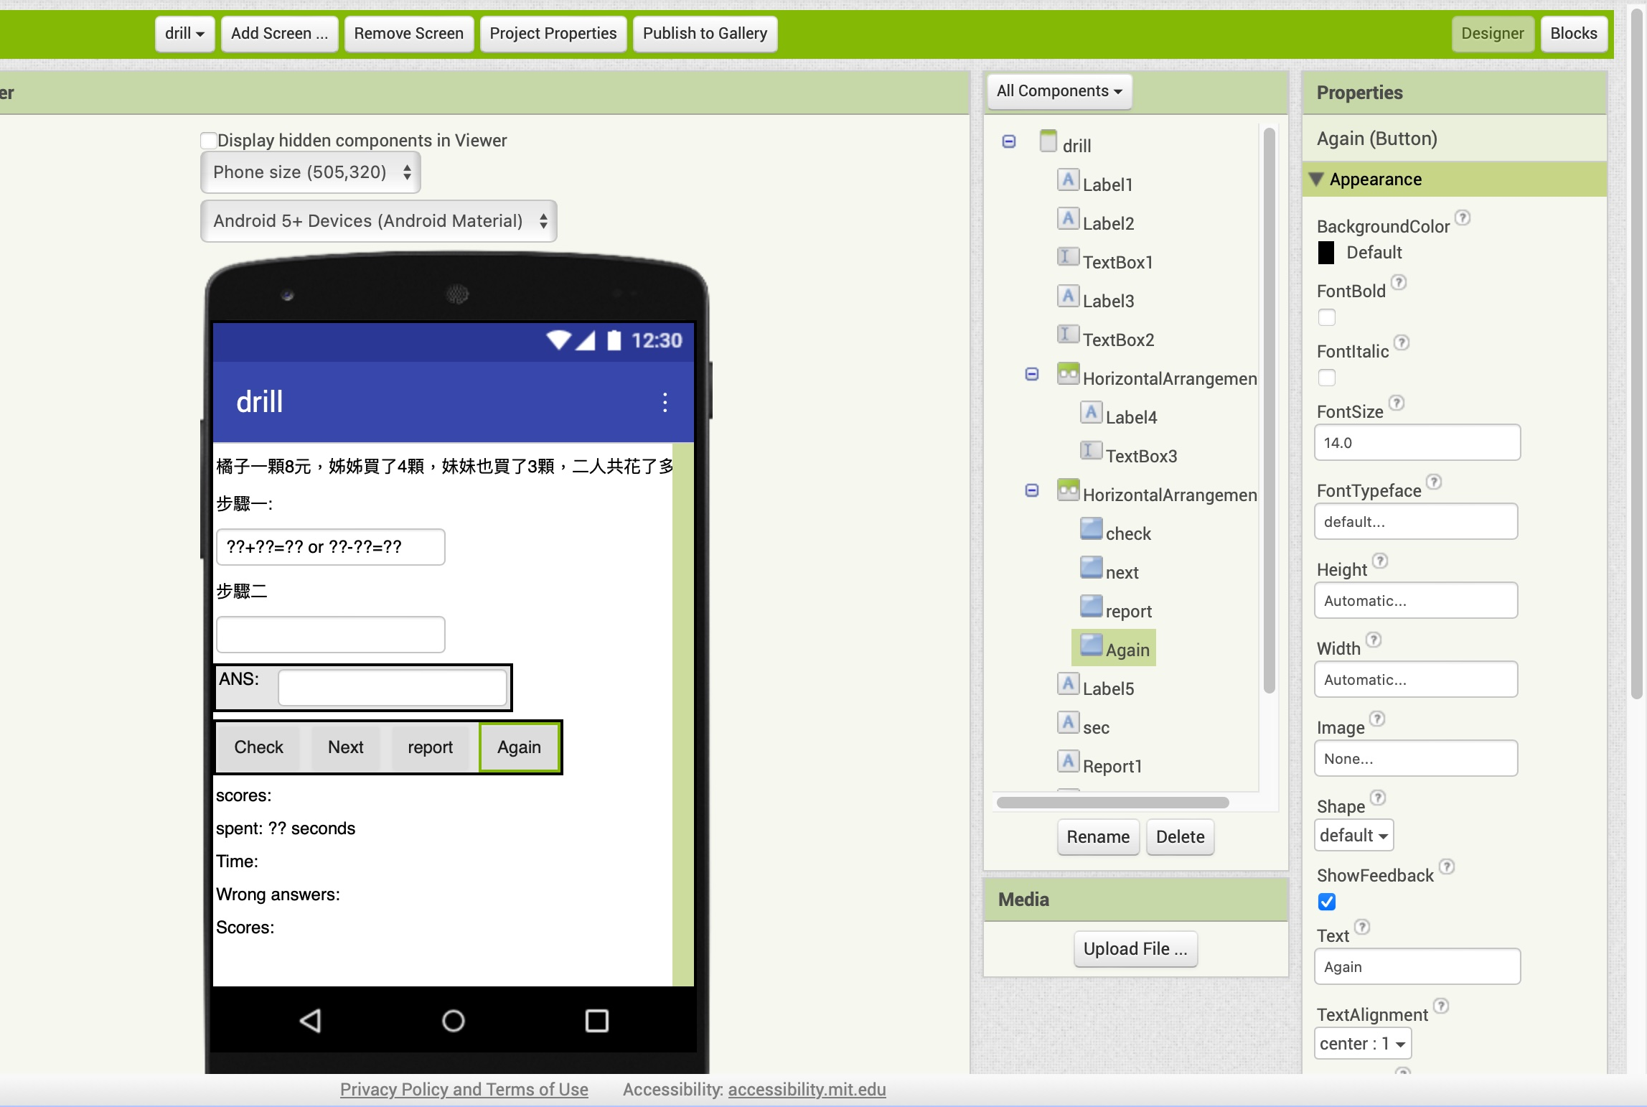
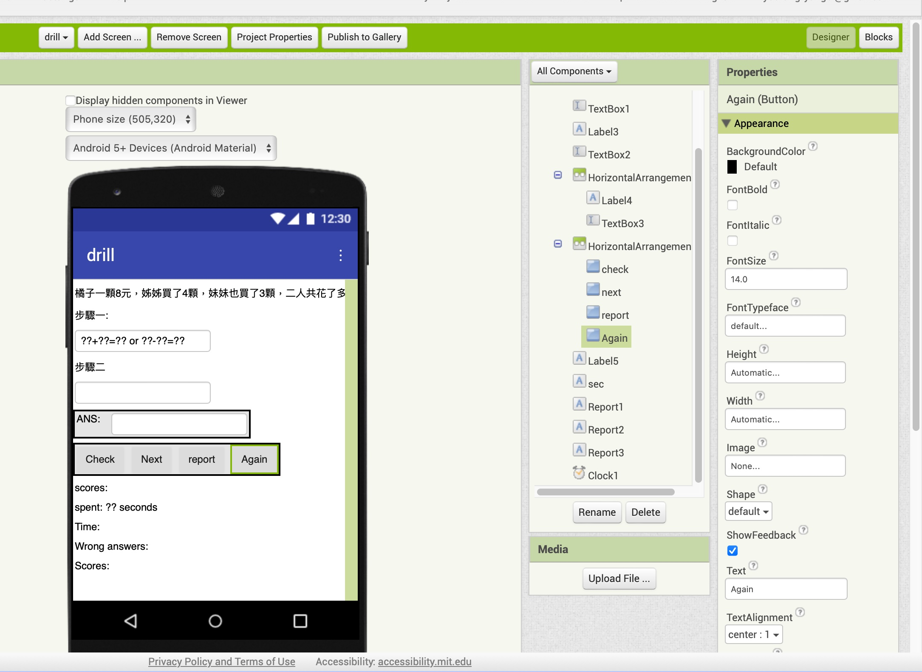
UI

Slide 5
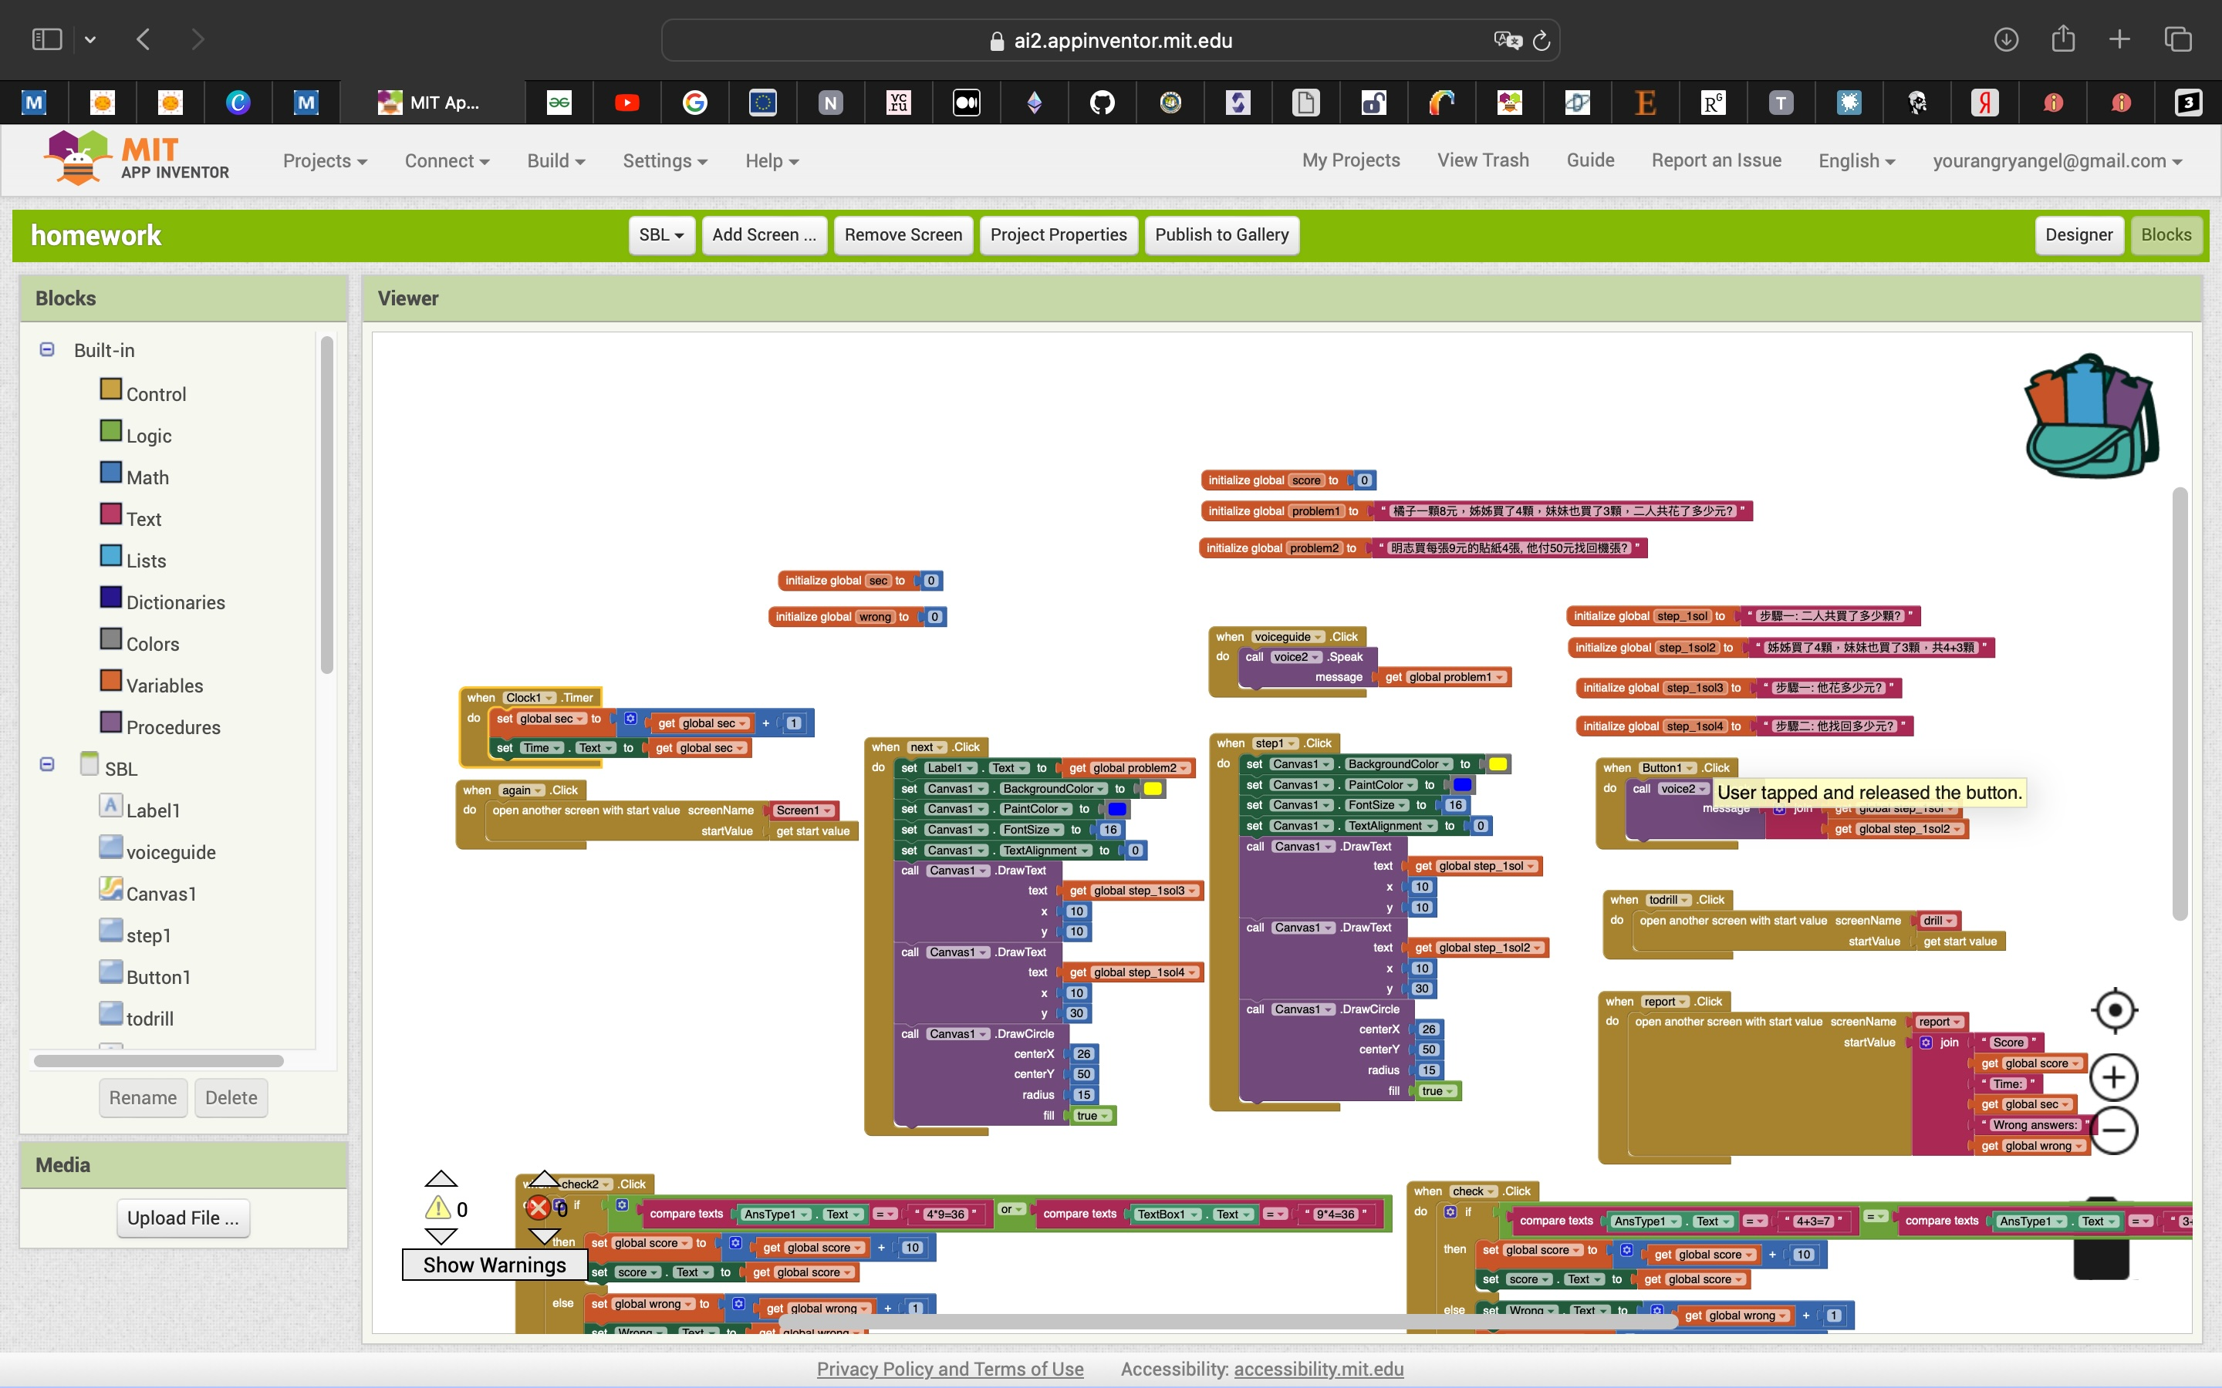
Code (SBL 頁)
Initialize 問題
譯音解題說明
步驟一和步驟二說明
Timer
下一題的按鈕
report: 成績(含學習時間)、鼓勵語音

Slide 6
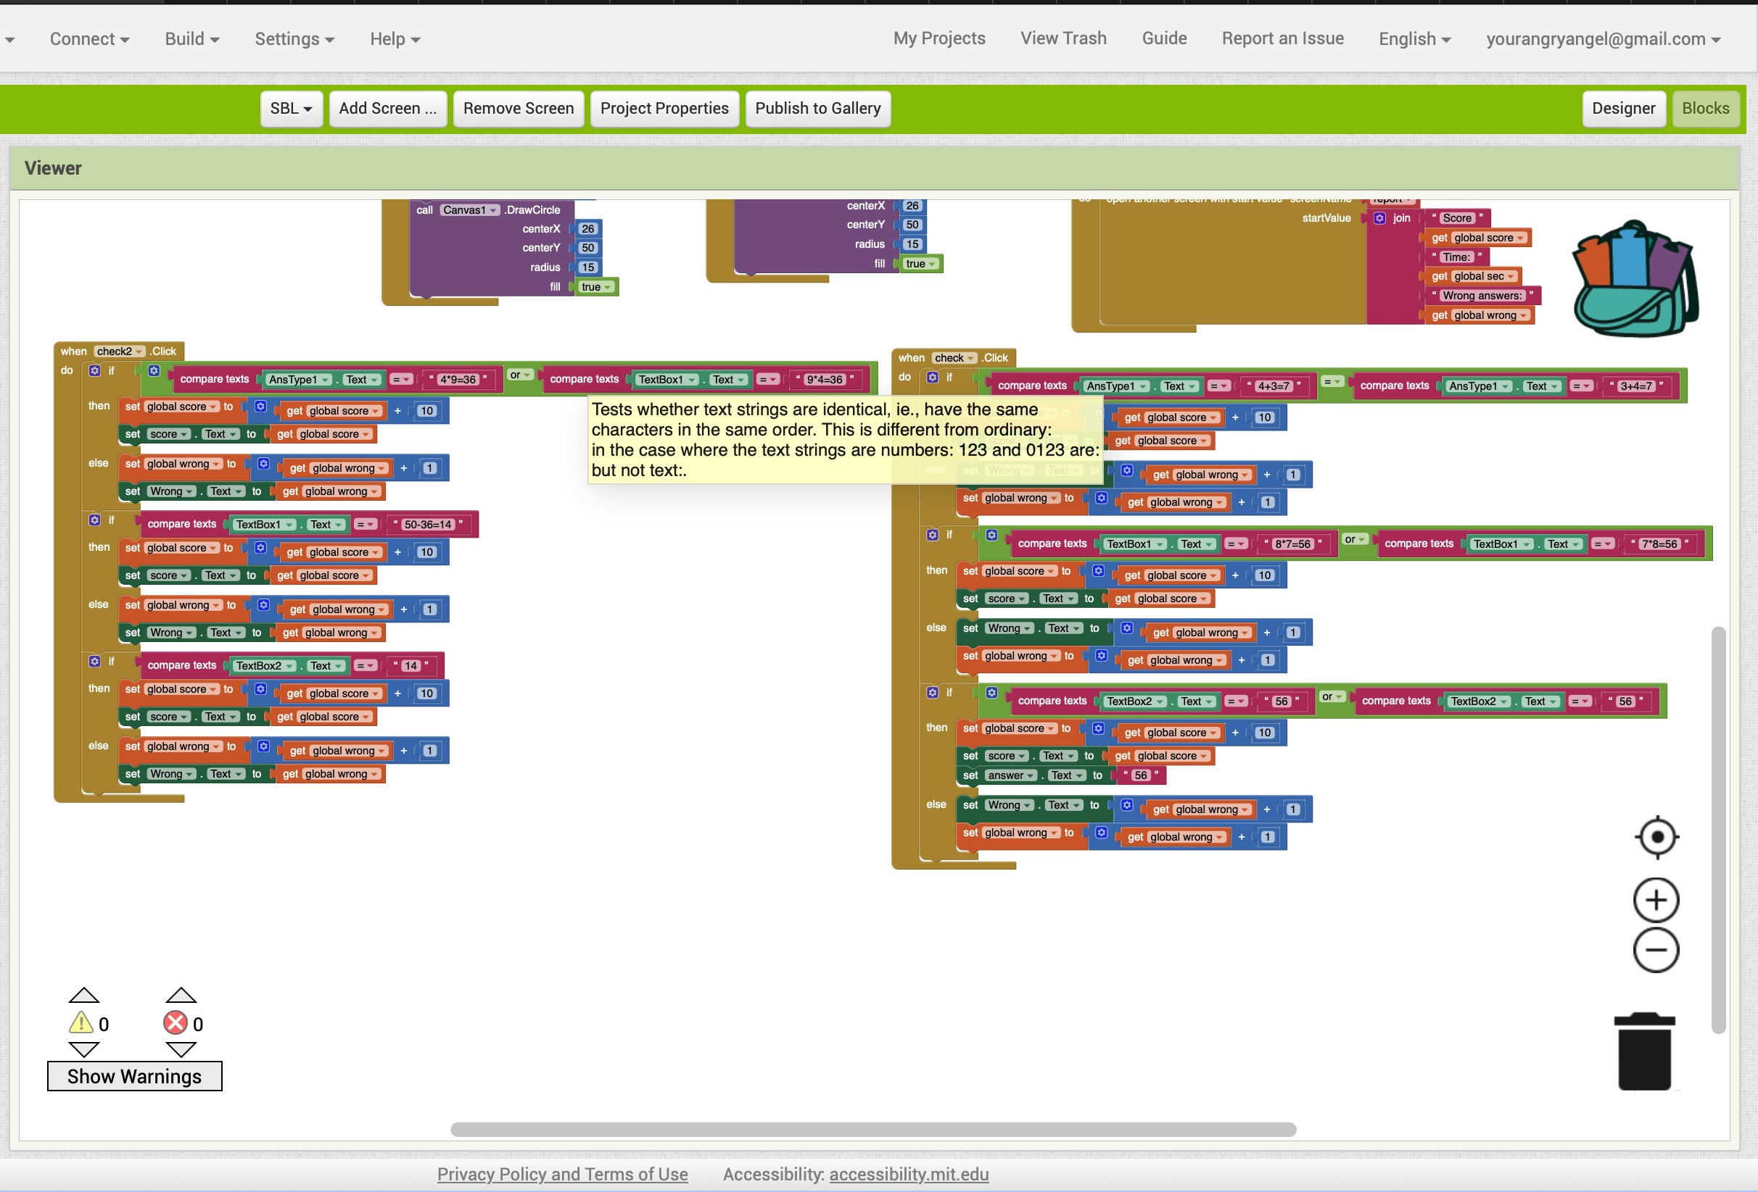
檢查答案for the first question
檢查答案for the second question
check1
check2

Slide 7
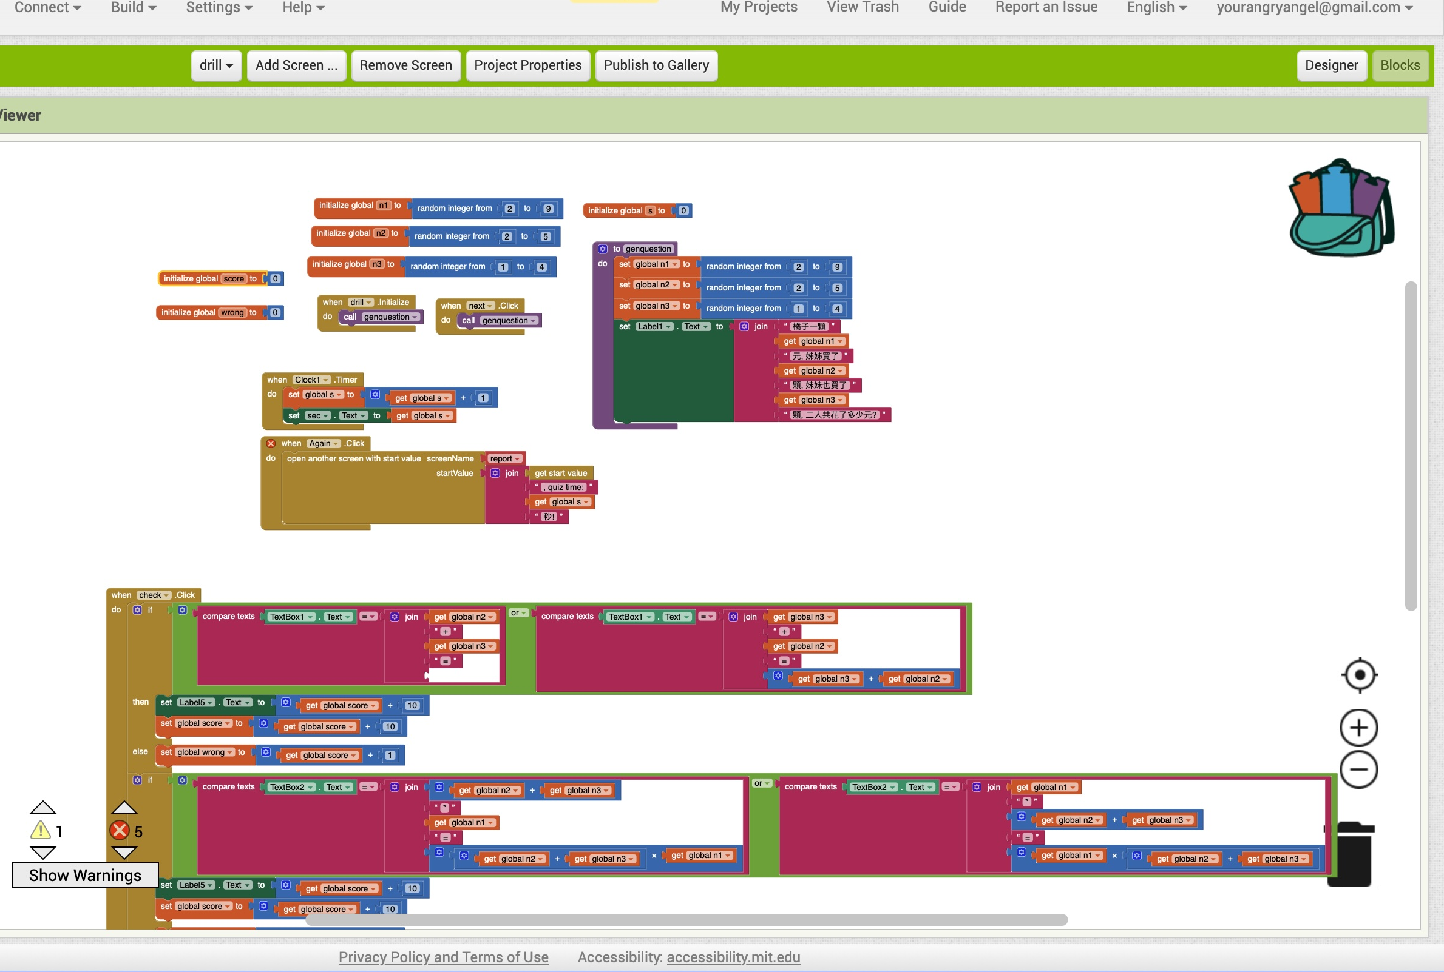
Code (Drill)
Initialize score 和wrong
操作了檢查部分
如果輸入的text等於正確的答案
…Score +10

Slide 8
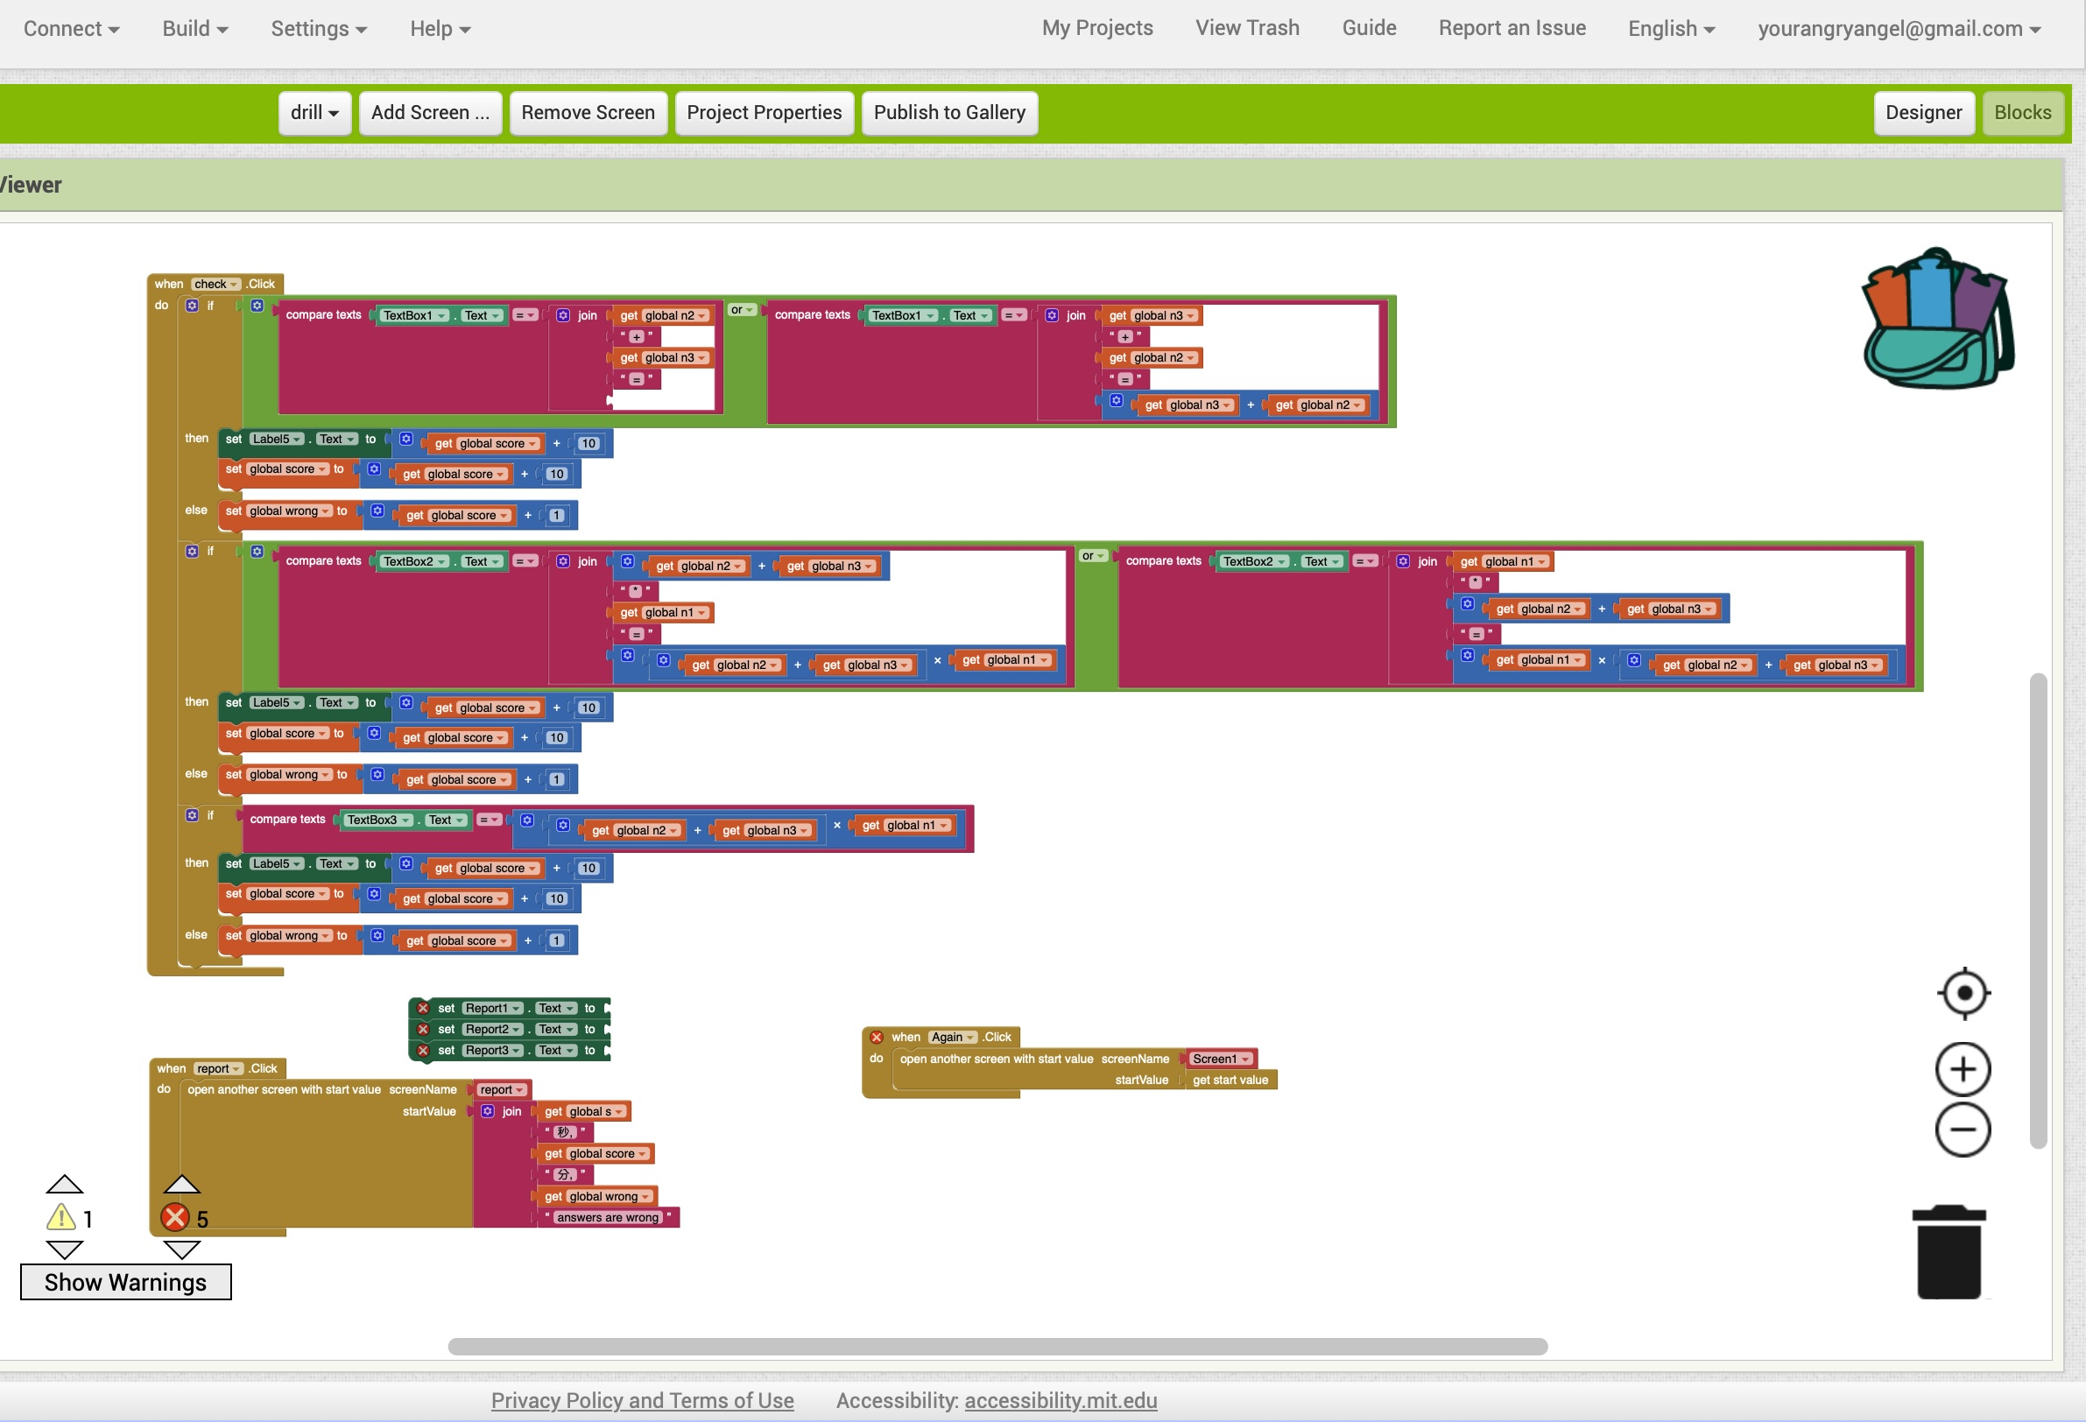
增加了
回來首頁重新開始遊戲
開report的一頁按鈕

Slide 9
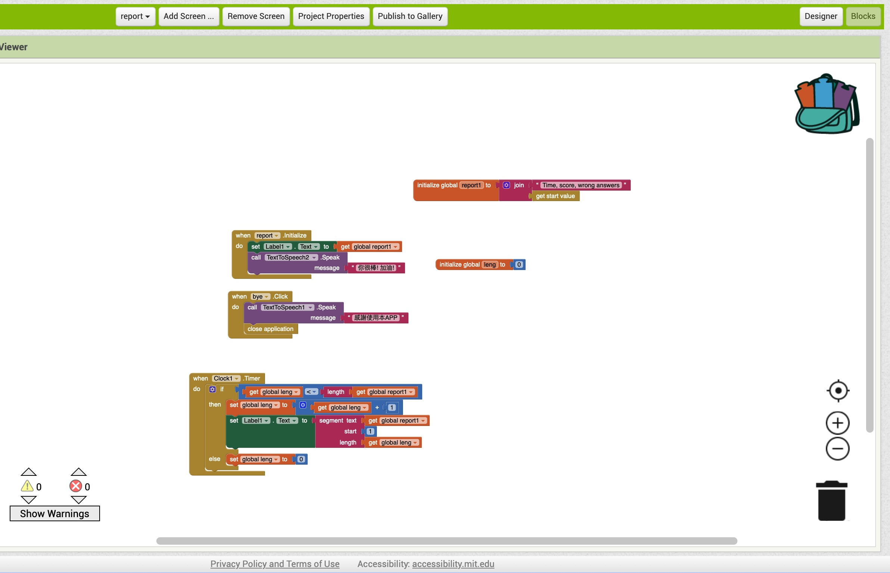
Report code
成績(含學習時間)
鼓勵語音

Slide 10
流程圖
Y
N
If
Text_Type1 = =50-36=14
Begin
(Check1.click)
Wrong +1
Score +10
SBL
Initialize: score, sec, wrong, problem1, problem2
Step 1_sol, Step 1_sol2
Y
If
Text_Type2 = 14
N
Score +10
Wrong +1
Y
If
Ans_Type == 4*9=36
Or 9*4==36
N
End
Score +10
Wrong+1

Slide 11
Y
N
If
Text_Type1 == 7*8=56
Or
8*7=56
Begin
(Check2.click)
Wrong +1
Score +10
Initialize: score, sec, wrong, problem1, problem2
Step 1_sol3, Step 1_sol4
Y
If
Text_Type2 = 56
N
Score +10
Wrong +1
Y
If
Ans_Type == 4+3=7
Or 3+4=7
N
End
Score +10
Wrong+1

Slide 12
Drill 流程圖
Y
N
If
TextBox2 == sum(n2,n3)*
n1
Or
N1*
Sum(n2,n3)
Begin
(Check.click)
Wrong +1
Score +10
Initialize: score, sec, wrong, n1 = random 2~9, n2 = random 2~5, n3 = 1~4
S=0
Y
If
TextBox3=
sum(n2,n3)*
n1
N
Score +10
Wrong +1
Y
If
TextBox1== n2+n3=sum(n2,n3)
Or n3+n2=sum(n2,n3)
N
End
Score +10
Wrong+1

